Slide 1
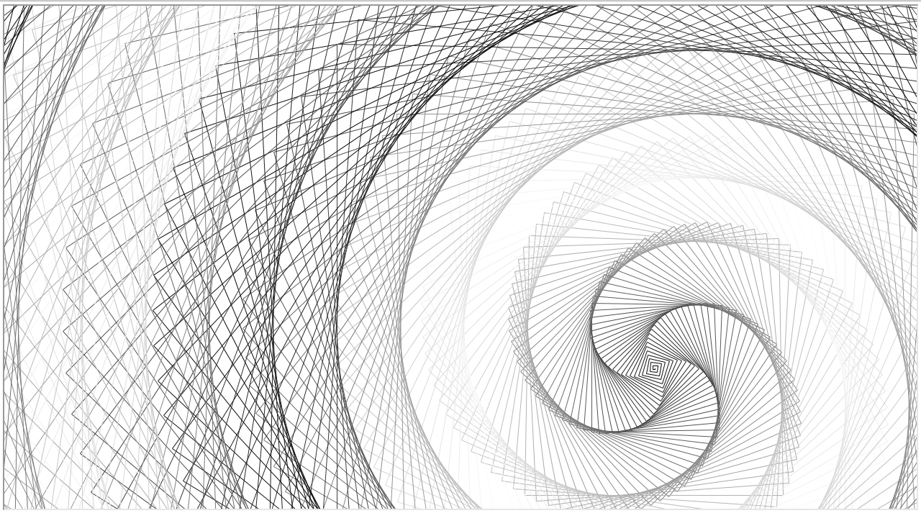
PYTHON
TURTLE
WOLP Jan 15
Brian Sharland

Slide 2
Hello!
Brian Sharland
Head of ICT and Computing at Bartholomew School
@sharland
http://briansharland.com
http://ikhowudi.com
http://github.com/sharland

Slide 3
Getting yourselves setup
Load Python IDlE GUI
Open the template I have made available (good idea also to make a copy of that template first)
It won’t be long before you are editing your own code!
Enjoy ☺

Slide 4
Resources
Python Turtle Docs
https://docs.python.org/3/library/turtle.html
My Turtle Folder on Dropbox
https://www.dropbox.com/sh/edis6nsn5t3yaka/AADVCZQaXYLxmaHFX0dGBczLa?dl=0
Turtle Videos
https://www.youtube.com/playlist?list=PLpGGOwJFWaFSiMX3kVg4PlQB_ABb2ygWj&spfreload=10

Slide 5



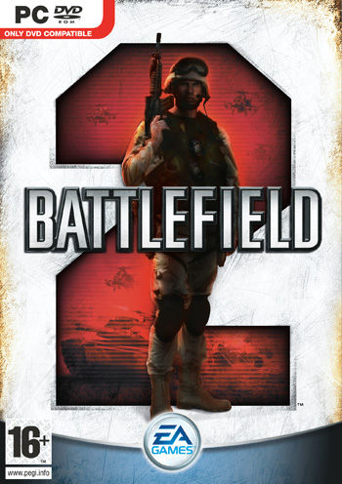
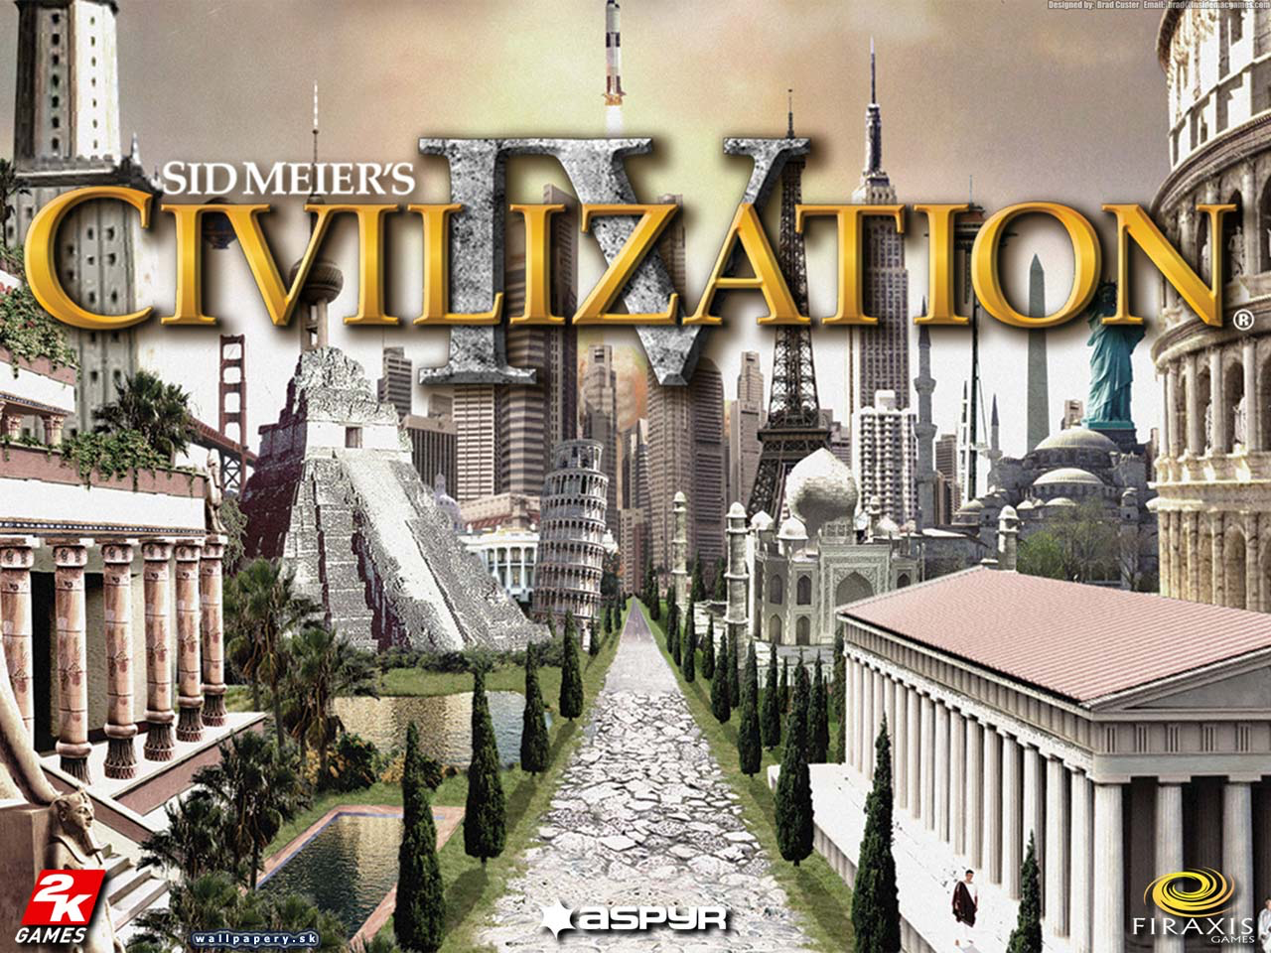


Why Python?
Python is a popular choice for an introduction to text-based programming languages
It’s powerful, relatively easy to understand, used widely outside school and there are many resources available

Slide 6
Learning text-based languages
Even if pupils have had experience of something like Scratch, text-based languages can be hard
Can be tricky to understand how code relates to output on screen
The nested for loop might make sense to some pupils but might lose others
Python and Turtle might make the jump from Scratch to text-based languages easier
#routine for hotel floor and room cleaning exercise
for floor in range(1,7):
for room in range(1,5):
print("Room",floor,room,"cleaned")

Slide 7
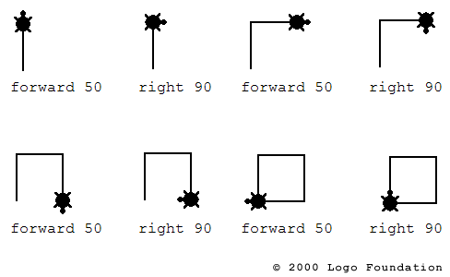
Why Turtle?
Many may remember some working with turtle and Logo for teaching simple coding concepts
It was OK but I think a bit limited
The Python Turtle module is an immensely powerful module with a number of methods which can be used in creative ways

Slide 8
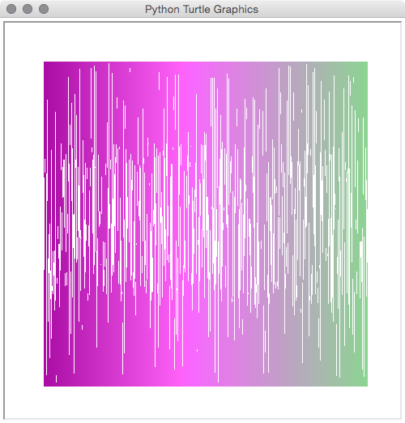
Computing and Creativity
Using the Turtle module taps into the creative aspect of computing
Pupils in a way are not restricted by the confines of a task ‘eg create a program which does x in order to progress’
Instead it is ‘create a program which uses methods x, y and z in largely any way you like in order to achieve whatever you want’

Slide 9
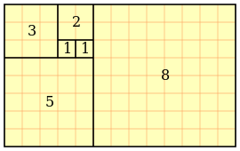
Computing and Maths
At the same time as developing creative skills using the turtle module will also develop maths skills and spatial awareness
In teaching this to pupils you might ask them to build a triangle or a pentagon
An easy way to challenge them on basic mathematics but with the possibility of extending them very quickly
Eg work with Fibonacci!
Can you write a Fibonacci sequence
And then draw it?

Slide 10
Improve assessment
from turtle import *
title('Draws a series of circles’)
for i in range(5):
right(72):
for x in range (1,73):
forward(150)
right(95)
mainloop()
If you had asked pupils to produce the nested for loop ‘hotel’ exercise earlier they might have all produced largely same response
If you instead ask pupils to use a range of methods to create a piece of art of their own design you will get a much wider range of responses
EG: this is one of the basic scripts I teach pupils how to create. From this you can add and change many elements to create very different results

Slide 11
Lesson Structure
Did not want pupils sat for too long doing same simple exercises
Begin with demo of about 10 to 15 minutes
Allow pupils time to watch pre-recorded videos containing challenges or ideas
Summarise at the front at the end with any issues which we came across or show examples of good pupil work

Slide 12
Differentiation
Pupils with different educational requirements
Step a pupil back to Scratch and get them to plan a turtle drawing in Scratch before trying again in Python
Use pair programming if appropriate
Gifted and Talented
Pupils who were moving very quickly were shown the official Python docs for turtle and challenged to try new methods
Encourage them to download other examples and hack them to do something different (teach them about crediting sources!)

Slide 13
Teaching programming constructs
I am going to take you through a few short examples of how we have used Turtle to teach key programming constructs
Variables
Loops
If Else
Functions

Slide 14
Getting started with Turtle
The template I have given you contains some of the code you will use on a regular basis when working with Python Turtle
There is an additional template with a save image function written inside it
This is useful for pupils keeping additional evidence of their work
The image is saved in an EPS format which is editable within Adobe Illustrator
Go through the template with your pupils but it will speed up building in class
Warning – do not save any files as turtle.py! This will conflict with the module

Slide 15
from turtle import *
title("Enter window title")
setup(500,500)
speed(0)
colormode(255)
#All turtle code below here
#Don't put anything after here
done()
Imports turtle module
Creates a window with title
Size of the window
Speeds up animation
Needed for any color work
A space for writing the turtle code
Allows you to exit window cleanly on finish

Slide 16
Importing modules
You may have noticed that I use the
from turtle import *
Rather than
import turtle
This is because

Slide 17
First methods
The first methods I would like you to use within your first script are (add them between the comments in the template)
forward()
right()
left()
backward()
These methods all take a single parameter which is either distance or an angle
Can you build a triangle?

Slide 18
Introducing variables
distance = 100
angle = 120
forward(distance)
right(angle)
forward(distance)
right(angle)
forward(distance)
right(angle)
The parameters which we used for the methods can be updated but if you have repeated them in a number of methods it could a while to fix
Introduce variables as a way to pass a parameter into the method

Slide 19
Understanding Loops
So far we have used simple methods to create a shape
You might have noticed that you were repeating methods when creating your shape
In a class situation this would be a perfect time to introduce a for or while loop

Slide 20
Next exercise
for i in range(72):
forward(100)
right(85)
Can you use a for loop to build a simple shape?
Some additional methods which could be used for interesting effects
penup()
pendown()
Here is my suggestion:

Slide 21
Working with colour
r = int(input(“Enter red value 0 – 255:”))
g = int(input(“Enter green value 0 – 255:”))
b = int(input(“Enter blue value 0 – 255:”))
pencolor(r,g,b)
for i in range (72):
forward(100)
right(75)
Up until now you have been working with black lines
Let’s introduce some colour
colormode(255) should have been set – this allows you to use RGB colour valuables
Define these as variables at the beginning of the script which will give you greater control
Try the script on the right

Slide 22
Working with additional modules
import random
for i in range (72):
r = random.randint(0,255)
g = random.randint(0,255)
b = random.randint(0,255)
pencolor(r,g,b)
forward(100)
right(75)
Importing the random module in conjunction with colours, distances and angles can give some very interesting effects
Add the import statement after the turtle module import
Note where I put the random declarations – what do you think will happen to the colour within the for loop?

Slide 23
If Else statements
When teaching the If Else construct a good approach to use is considering co-ordinates on the turtle screen
Get pupils to then test if turtle is within that area and get it to do something different
Take a look at marking_area.py in the accompanying folder
How could you get it to test for a different area?
Can you get it to do something different?

Slide 24
Functions
def moveForward():
forward(10)
stamp()
def moveBackward():
backward(10)
dot()
def turnLeft():
left(45)
def turnRight():
right(45)
listen()
onkey(moveForward,"Up")
onkey(moveBackward,"Down")
onkey(turnLeft,"Left")
onkey(turnRight,"Right")
It is possible to teach object oriented programming using Turtle but I don’t with KS3
Turtle lends itself to structured programming very well and it is a good point to start teaching functions
Take a look at simple_functions.py in the folder at what it can do – can you extend it?

Slide 25
In conclusion
Loads of extra methods in the python turtle documents
Get creative
Let pupils spend as much time as possible coding
Challenge each other
Go wild!
Any questions

